Slide 1
Engineering People Skills
Sept 2025

Slide 2


Speaker
Harsha Sridharan
Sr. Software Engineer
Yi Liu
Software Engineer II
4.5 Years @ Microsoft – People Skills Engineering
Masters in Computer Applications – India.
Expertise in backend adaptability, performance tuning, and cross-functional delivery.
Active in Microsoft ERGs & D&I initiatives
Passionate about mentorship and early-career talent development
Enjoys outdoors, tech blogging, and speaking at conferences.
3.5 Years @ Microsoft – People Skills Engineering
Masters in System Science – Canada.
Expertise in building scalable, user-centric applications with modern frameworks and cloud technologies.
Passionate about designing AI solutions that enhance productivity and empower users through intelligent automation.
LinkedIn
LinkedIn

Slide 3
Agenda
Introduction
Engineering Deep-Dive
  Backend
  Inferencing
  Frontend
Privacy & Compliance
Q&A

Slide 4
Questions...
Individuals
How do you currently keep track of your skills and expertise?
How you keep them updated?
Do you feel your skills are visible to the right opportunities? feel your skills are visible t
Leaders
Do you struggle to understand the breadth of skills on your team?
How do you identify who can take on what work quickly?
What challenges do you face in aligning skills with business priorities?

Slide 5
Enabling the frontier firm
The next era is powered by AI and guided by people. The future belongs to companies that seamlessly integrate the scalability of AI with the ingenuity of people.
AI skills
AI skills are the distinct competencies of a generative AI model, encompassing its ability to process, analyze, generate, or interact with information in ways that provide value to users.
People skills
People skills are the unique combination of an individual’s technical expertise, interpersonal abilities, and behavioral competencies that drive their productivity, collaboration, and personal growth within an organization.

Slide 6




Introducing: People Skills
AI that understands your business and your people
Advanced skill inferencing
Combine productivity signals with advanced AI reasoning to accurately infer user skills
In the flow of work
Bring skills to the tools and platforms where users already spend their time
Robust privacy controls
Admins and users are fully in control of their skills experience and data

Slide 7


Capabilities
M365 Copilot + Agents
Copilot Analytics
People surfaces
Skills based learning
Power Microsoft 365 Copilot experiences with accurate information about your people’s skills and capabilities
Provide contextualized answers to people-related queries in Microsoft 365 Copilot
The M365 Copilot enables employees to easily find the right people in the organization for a given need and understand colleague’s skillsets
Leaders can use the M365 Copilot to inform strategic workforce planning decisions with an up-to-date view of talent landscape strengths, gaps, and opportunities.
Built-in dashboards provide leaders with the tools to assess skills across their business
Skill landscape reports highlight organizational capabilities and opportunity areas
Detailed drill downs and skill hierarchy views enable targeted skill assessments by business groups
Frequent cadence refresh provides
an up-to-date view for timely
and informed decision making
Search in People Companions for skills to identify people with the right capabilities for your project
View inferred skills and customize
your personal skills profile
See colleague’s skills from the
people card across M365 surfaces
Filter by skills in org explorer to
identify skillsets within people
and team groups
Identify skills you want to grow
View skills-based learning recommendations, personalized
for you, directly from your Viva Learning experience
Learn in the flow of work with
a skills-based experience natively embedded within Teams and M365
Built-in taxonomy + flexible taxonomy management
Seamless setup + easy administration
APIs supporting ingress and egress
Microsoft security and trust

Slide 8
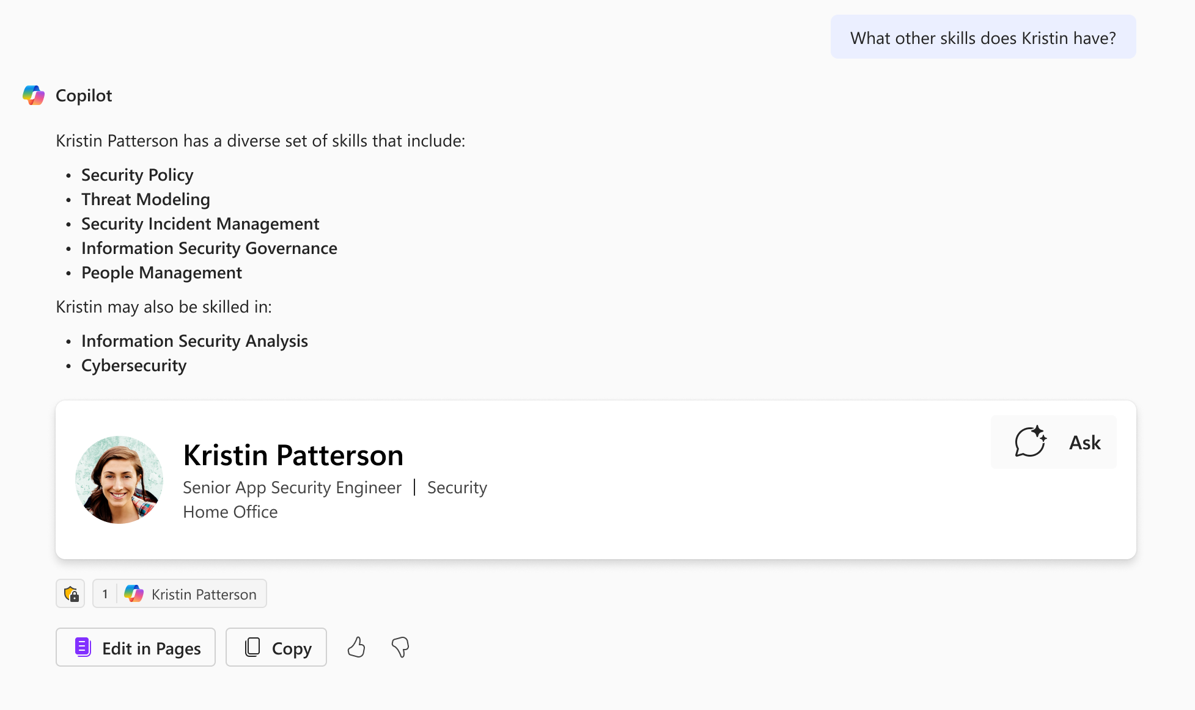
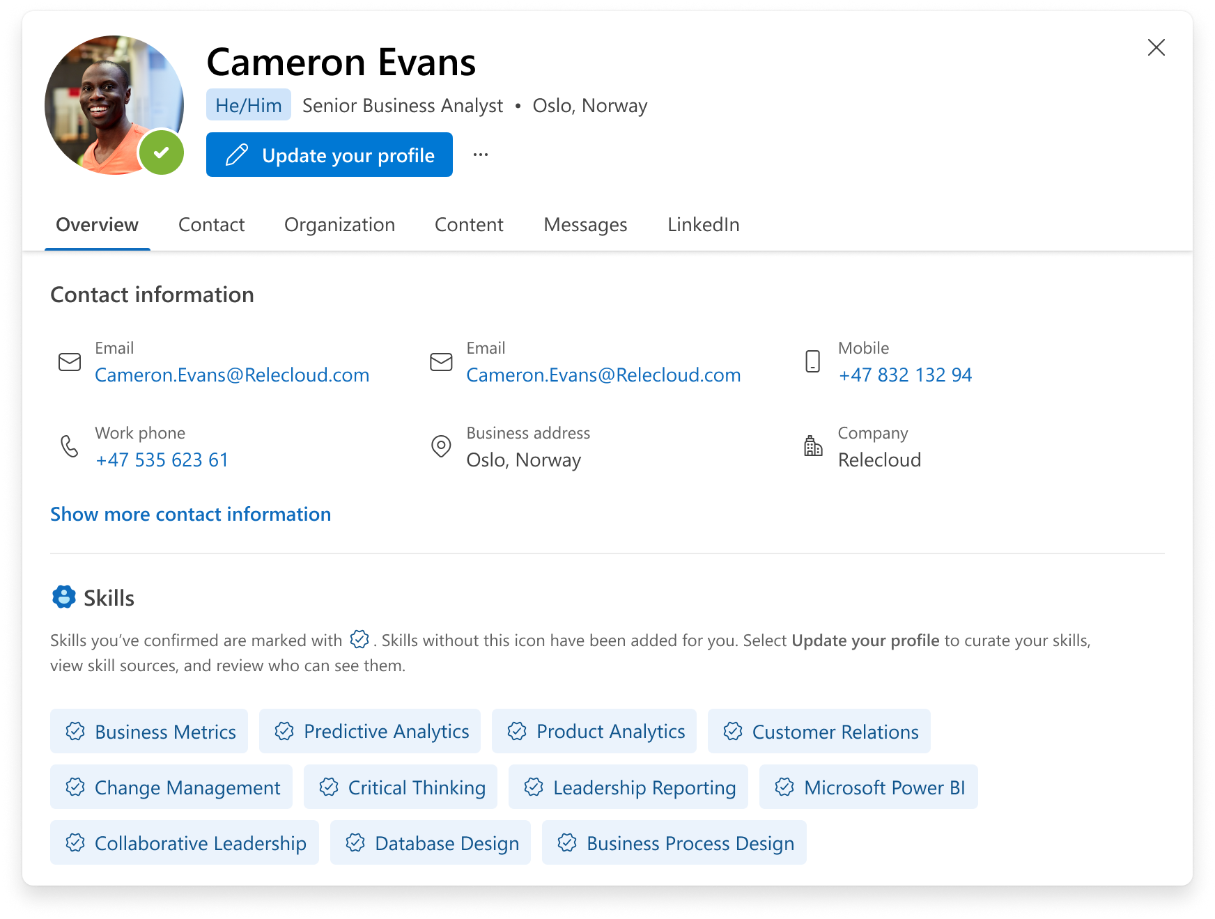
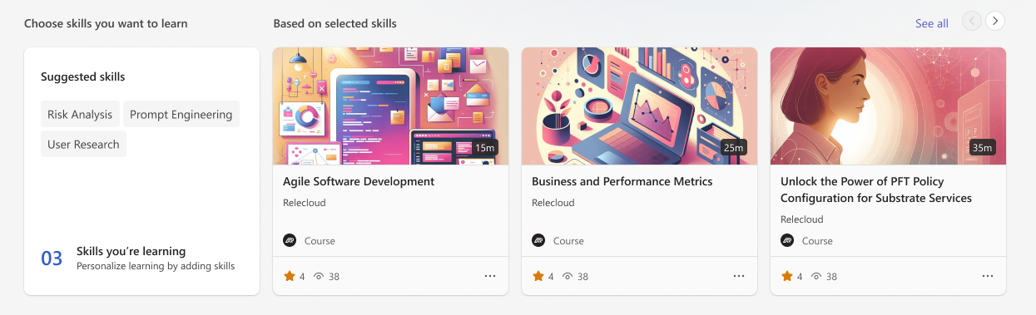
People Skills for Employees
Empower employees to discover, connect, and learn about others:
Find the right person to get help from
Get to know someone with a more complete view
Prepare for meetings and tailor communication
Skills based learning journeys

Slide 9
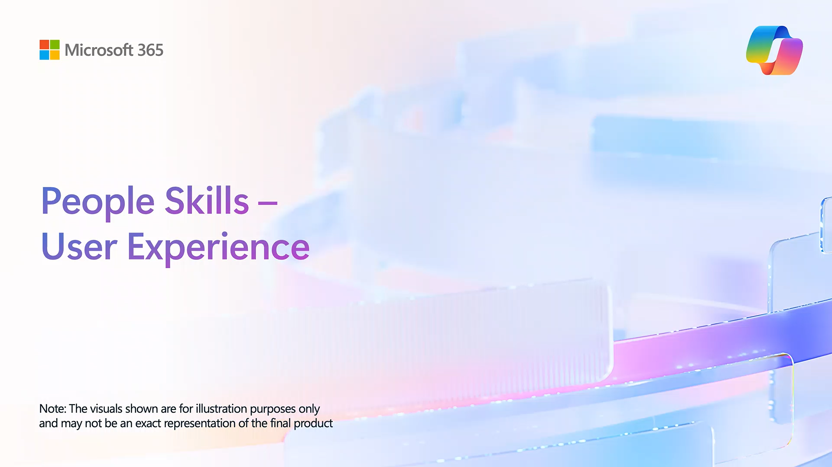

Slide 10
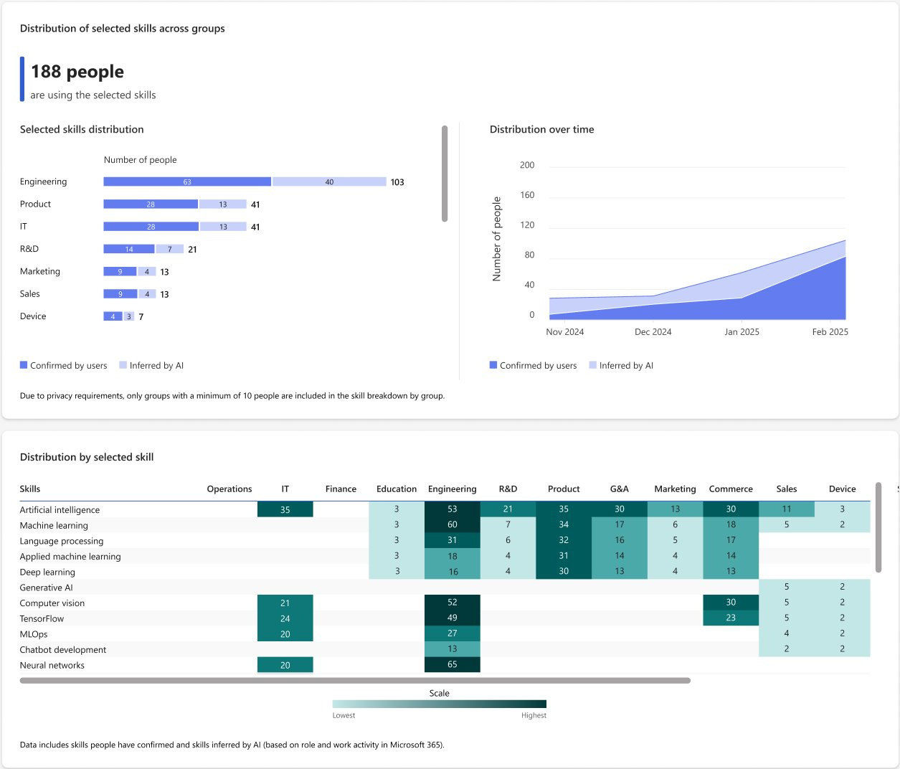
People Skills for Organizations
Provides organizations with scalable, up-to-date talent landscape reports to enable:
Skills gaps or surpluses analysis
Strategic upskilling planning
Strategic workforce planning (hiring, reorganizations)
Tracking skills over time

Slide 11


Slide 12
Service
Architecture

Slide 13
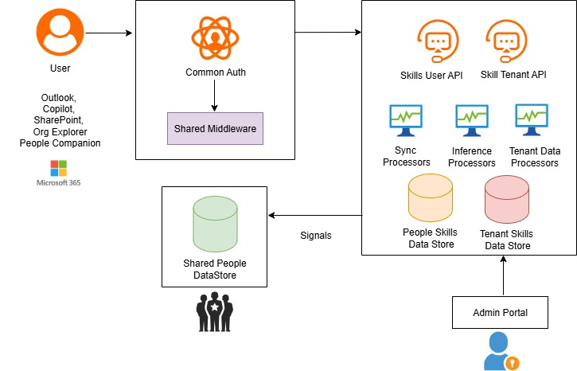
BACKEND ARCHITECURE

Slide 14
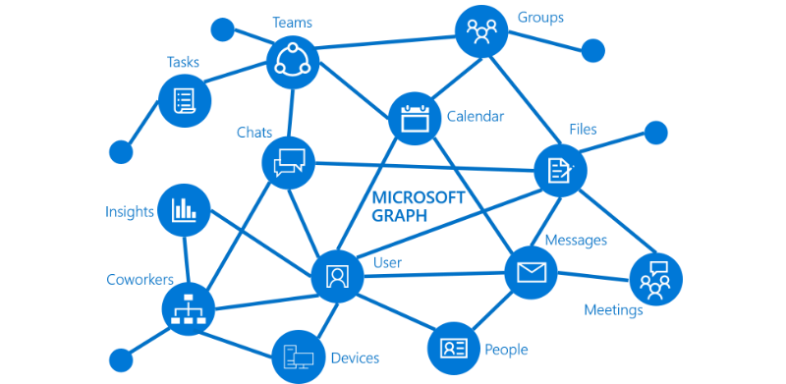
MS GRAPH
Microsoft Graph
Graph API is unified API gateway to data and intelligence in Microsoft 365, Microsoft Entra, and other Microsoft cloud services.
Enables secure, scalable access to organizational and consumer data.
Skills Data with Microsoft Graph:
Allows us to fetch user skill profiles programmatically.
Allows to integrate skill insights into our apps, workflows, and dashboards for personalized experiences.
Why Microsoft Graph?
Simplifies development with one API for all Microsoft cloud data.
Powers smarter, more connected applications.
Supports secure, compliant access to enterprise information.

Slide 15
Inference
Architecture

Slide 16
INFERENCE FLOW
Know all the relevant work activities for the user
Extract the keywords associated with the users
Transform the extracted skills info to vectors and store them for the user
Give recommendations of skills and similar skills based on skills taxonomy
Matching keywords to skills taxonomy via vectors comparisons

Slide 17
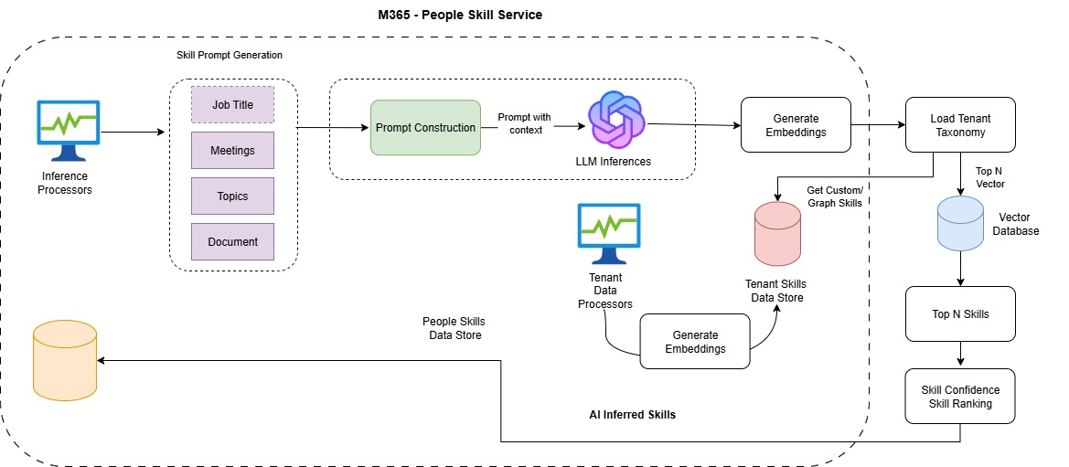
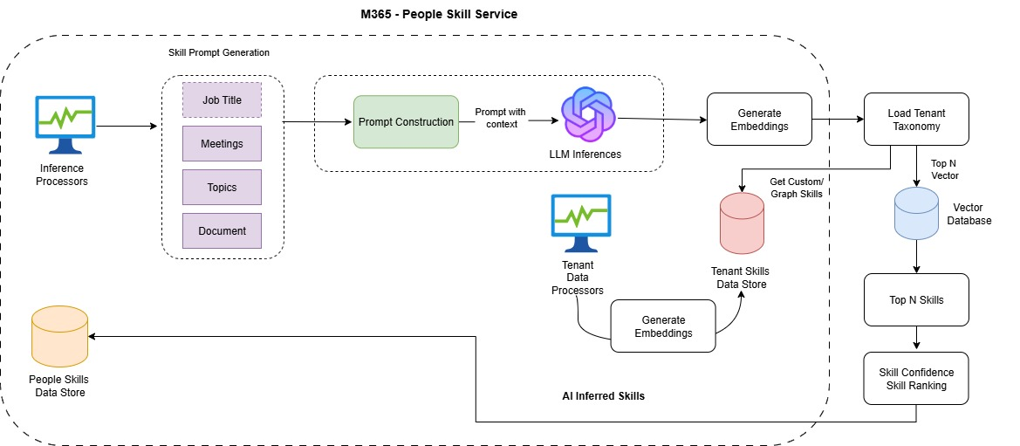
INFERENCE FLOW

Slide 18


Accuracy
INFERENCE FLOW
Performance
Training: Self-reported (Golden Dataset) profiles, Expert-validated samples
Ecosystem is extensible via tenant provided taxonomies.
Batch Inferences
Vector Database
Continuous Learning to improve accuracy further: User feedback loops
Refreshments (~30d) based on work activities
Multi-region writes and reads
Change feed supports real-time feedback loops and fast data refresh
High-speed I/O hardware
Runs during off-peak hours
Model Accuracy: Precision and Recall

Slide 19
Skills UX Engineering

Slide 20
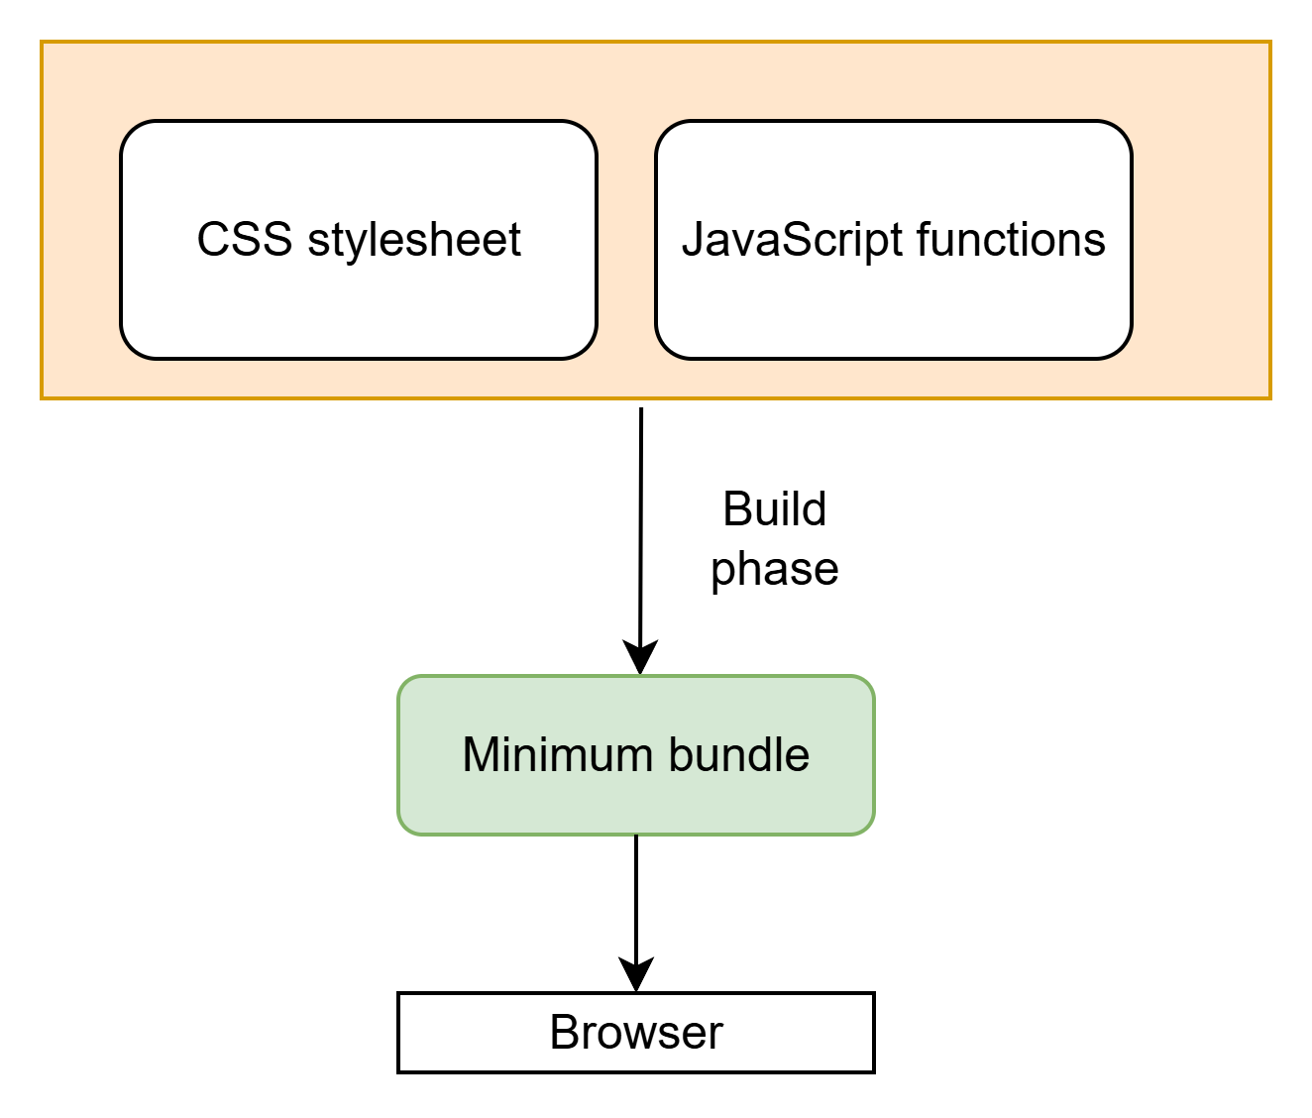
UX ENGINEERING
Fluent Design
Microsoft’s cross-platform design language and system for building coherent, accessible, and scalable digital product experiences.
Fluentui
Official open-source front-end framework
Granular, atomic styling – No unused CSS
Tree-shaking – No unused JS functions
Smart runtime caching
WCAG 2.1 – Accessibility standards
Notes:
As mentioned earlier, there are some integration into the client apps, which involves UI engineering efforts.
In order to ensure the experience felt native and intuitive across multiple products, we used Fluentui, an open source UI framework that has Unified common UI elements and theming. With it, we built our unified UI effortlessly.
In addition to unified UI,
When building UI applications, we have the two core components: CSS stylesheet defines colors, spacing, etc., functions written in JavaScript which do all the logic jobs. Before sending these resources to the client such as browser for users to see the final app, there is a build process to minimize the resource to ensure the size is minimal, and only necessary resources are used. Less memory is used in the device and users can have smooth experience.
How do we achieve the minimal sizes? We used granular atomic styling and tree-shaking features from fluentui:
Granular atomic styling is to write simple css styles – instead of creating giant styles with multiple style rules, we create small styles that does only one thing, this is useful in the build process to drop unused styles in the final bundle.
Similarly, tree shaking will drop the unused JS functions.
Additionally, we also use smart runtime client caches to prevent the recalculations on the layouts and elements rendering.
Finally, Fluentui supports high standard A11y out of box. The UI elements we adopted from fluentui have been tested thoroughly to adhere the inclusive design principal.
On top of that, we also conduct strict A11y tests on our products as a whole.

Slide 21

UX ENGINEERING
Frontend Performance
Fluentui performance boosts
Data services and CDN resources are served using location strategies
Render as you Fetch Pattern ⭐
    React 18 Suspense
    Relay
    React Query
    Next.js
Client & Service Cache
Consistently check our performance metrics to seek for improvements
Notes:
In addition to all the powerful benefits we get from this library, we also apply our own strategies to further improve the performance on the web engineering:
Location-aware delivery
Data services and CDN resources are served using location strategies. Content is delivered from servers physically closer to the user, ensuring faster load times.
Render-as-you-fetch pattern
Traditionally, data is requested after the UI is ready. In our approach, we fetch data as soon as possible, in parallel with rendering, so the UI doesn’t block data retrieval. This results in a smoother and faster content load.
Early Data Fetching:
Instead of waiting for a component to mount before fetching data, you initiate the fetch during an earlier phase, such as when a route is matched or a user action is triggered.
Preloading Data:
The fetched data is stored in a way that it can be accessed immediately when the component renders.
Caching
We leverage both client-side and server-side caching to reduce redundant complex computations and requests to improve responsiveness.
Continuous performance monitoring
We track performance metrics to identify areas for improvement.
We measure load times with respect for user privacy and collect feedback to focus our efforts on what matters most.
Together with Service performance boosts, the feature itself is designed to feel fast and native—it truly belongs in the M365 ecosystem.
We’ll talk about Service performance in the upcoming section: Service insights.

Slide 22
Setup
and Privacy

Slide 23
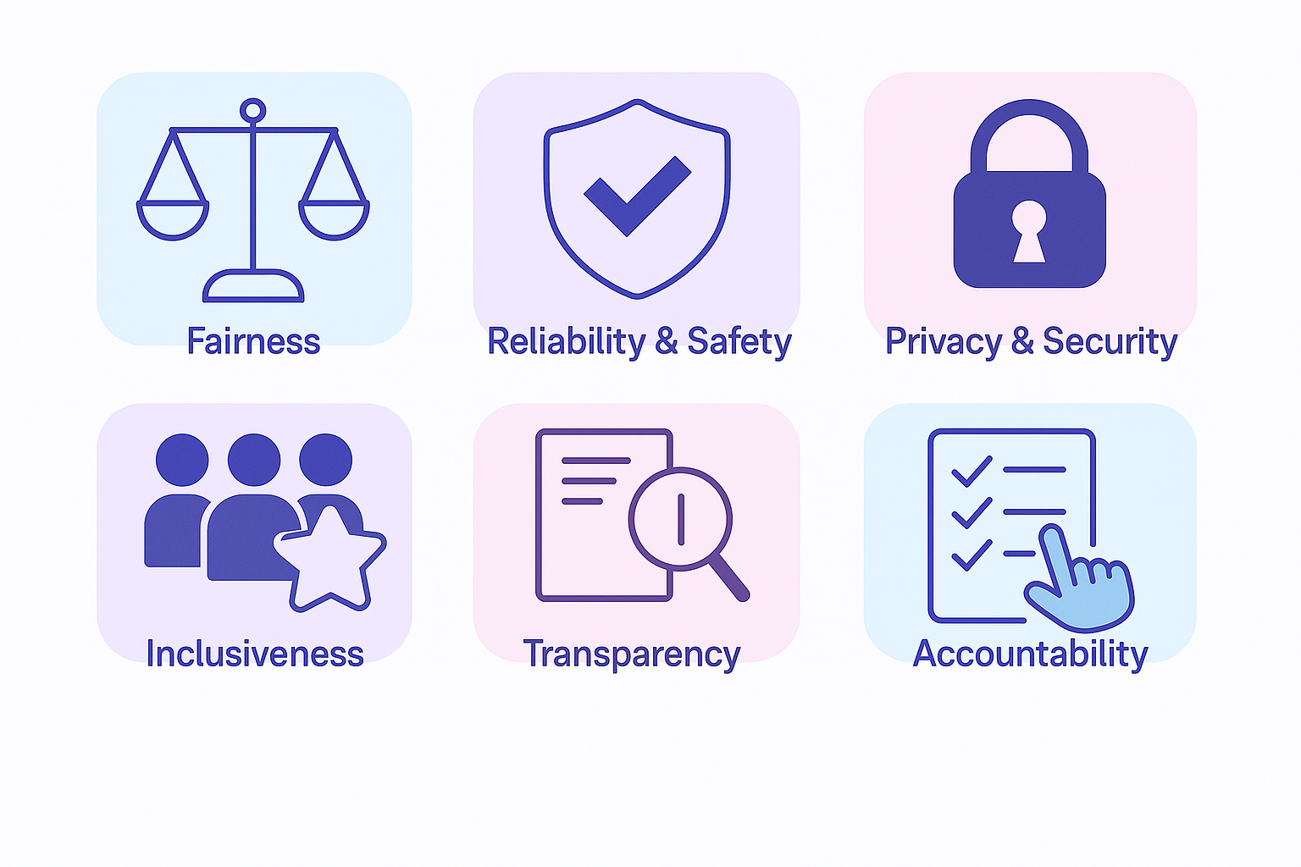
PRIVACY
Responsible AI
AI transparency in People Skills - Microsoft Support

Slide 24
PEOPLE SKILLS
Privacy controls offered
Admins can set default privacy settings for skills using Feature Access Management, by creating access policies that can apply across the tenant or only to particular users, groups or regions
Admins will have the option to:
Skills AI inferencing control
Enabled (default behavior) | Users can opt-out
Disable AI inferencing | Users can opt-in
Turn off inferencing | No user controls
Will users receive AI-based skill suggestions?
Admins will have the option to:
Skills visibility controls
Enabled (default behavior) | Users can opt-out of sharing
Disable sharing | Users can opt-in to sharing
Turn off sharing | Admins can disable some* user controls
Will user’s skills be shared with others in M365?
*We offer a control for user’s entire skills profile and granular sub-controls only for inferred skills and for third-party skills. Admins can disable user controls for inferred and third-party skills (i.e. restrict a user from sharing these skills)

Slide 25
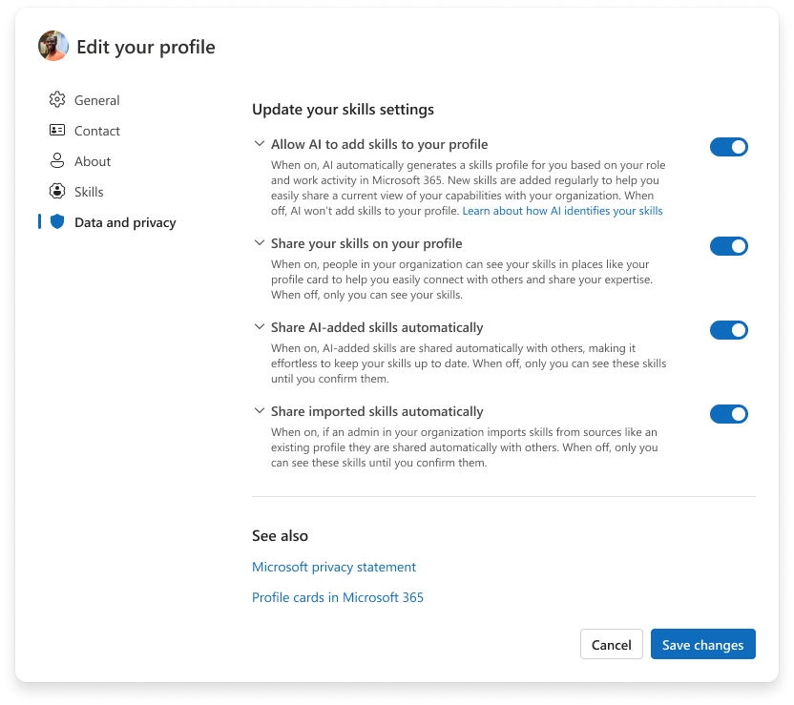
End-user privacy controls
Admins can set the default privacy settings using access policies, but end-users have ultimate control over their own skills
Users can manage their own preferences through the Live Profile Editor settings
Users can opt-out of AI inferencing suggestions
Users can hide some or all skills on their profile from being shared in other M365 experiences

Slide 26

Thank You !

Slide 27









Please thank our sponsors

Slide 28

Submit session feedback

